Slide 1


LLM-Systems Basics
EECS 598
Jiachen Liu
2024/1
Notes:
Freezing & happy to see everyone join us. The lecture would be very important
In this lecture
I will not only talk about the Basics of LLM, but more importantly talk about special characteristics that related to system design
why different design systems are needed for LLM, compared to previous CNN, RNN.
What are the new challenges or opportunities brought by LLM for system design
Assume some knowledge about ML / neural network, - high level idea but i will not involve complex math,

Slide 2
Agenda
Why Transformer and What is Transformer ?
Why LLM is unique in terms of System Design?
How can we better improve the system performance of LLM ?

Slide 3

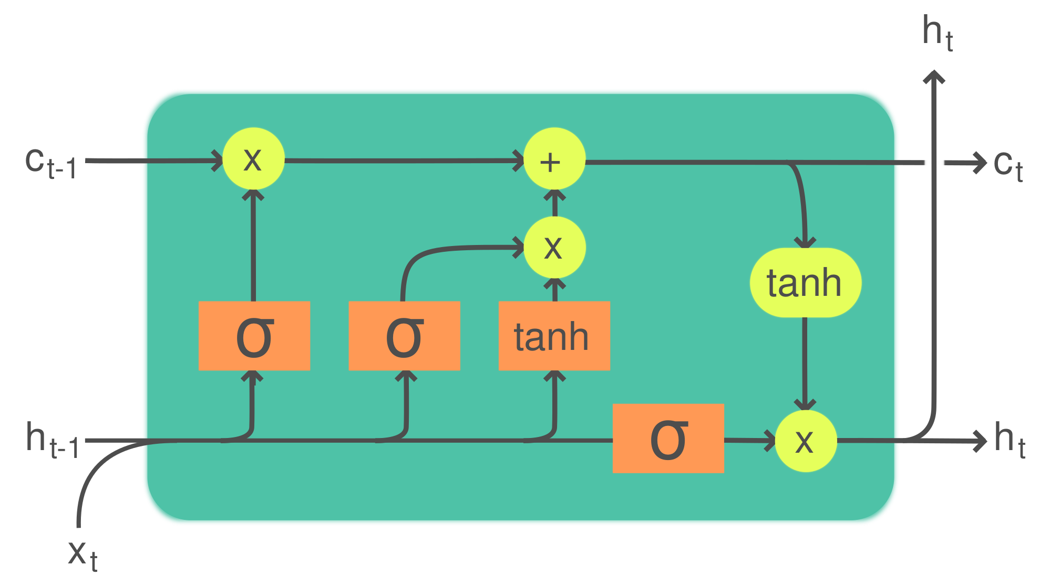
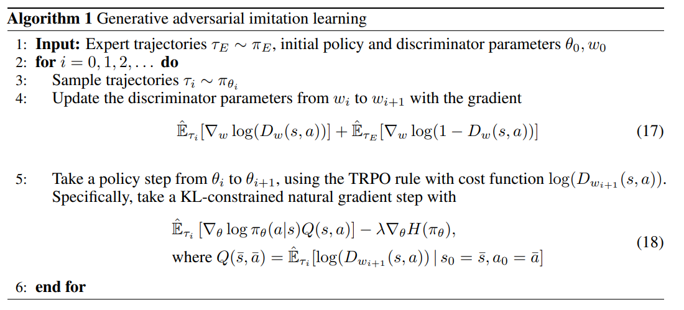
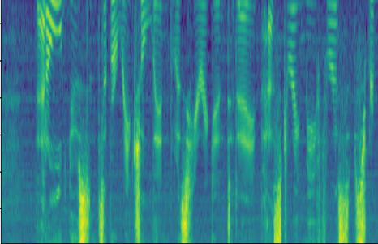
Computer Vision
Convolutional NNs (+ResNets)
Natural Lang. Proc.
Recurrent NNs (e.g. LSTMs)
[2]
h e l l o
[1]
Speech
Deep Belief Nets (+non-DL)
Translation
Seq2Seq
RL
BC/GAIL
s a l u t </s>
RBM
DBN
RBM
🔒
DBN
GRBM
🔒
DBN
h e l l o </s> s a l u t
[1] CNN image CC-BY-SA by Aphex34 for Wikipedia https://commons.wikimedia.org/wiki/File:Typical_cnn.png
[2] RNN image CC-BY-SA by GChe for Wikipedia https://commons.wikimedia.org/wiki/File:The_LSTM_Cell.svg
Notes:
Before transformer proposed by google
Each machine learning task had its backbone model architecture – CNNs dominated computer vision, RNNs were the linchpin for language processing, and so forth. But after transformers come to the world

Slide 4

Computer Vision
Natural Lang. Proc.
Reinf. Learning
Speech
Translation
Graphs/Science
Transformer image source: "Attention Is All You Need" paper
Notes:
unifying the approach to diverse machine learning tasks under one architectural umbrella. This shift has reshaped not just computer vision and natural language processing, but also fields like reinforcement learning, speech synthesis, translation, graphics, and scientific research.
That’s why you need to learn transformer really well to get into the world of genai
Let look at what is transformer, and how does it work

Slide 5
What’s happening inside Transformers?
Encoder-Decoder
Encoder
Decoder
Attention is all you need
Notes:
This is the architecture of original transformer in the paper

Slide 6
Decoder-only
GPT
Encoder-only
BERT
Enc-Dec
T5
Das ist gut.
A storm in Attala caused 6 victims.
This is not toxic.
[sat_]
[*] [*] [sat_] [*] [the_] [*]
Translate EN-DE: This is good.
Summarize: state authorities dispatched…
Is this toxic: You look beautiful today!
[START] [The_] [cat_]
[The_] [cat_] [MASK] [on_] [MASK] [mat_]
Attention is all you need
Notes:
researchers try to develop their own transformer for different purposes
there are mainly three ways of revolution for transformer variations

Slide 7
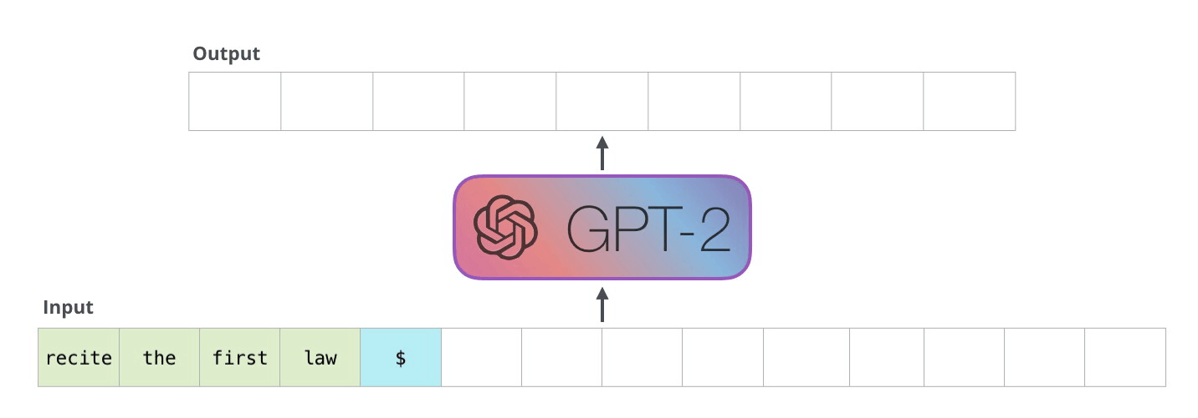
High-level Workflow of GPT Inference
Auto-Regressive Decoding
https://jalammar.github.io/illustrated-gpt2/
Notes:
The model generates one token at a time, taking into account previous token

Slide 8
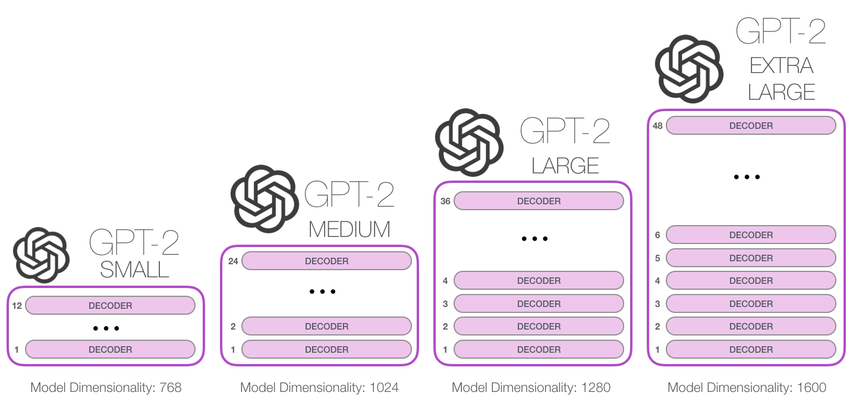
Zoom in GPT
https://jalammar.github.io/illustrated-gpt2/

Slide 9
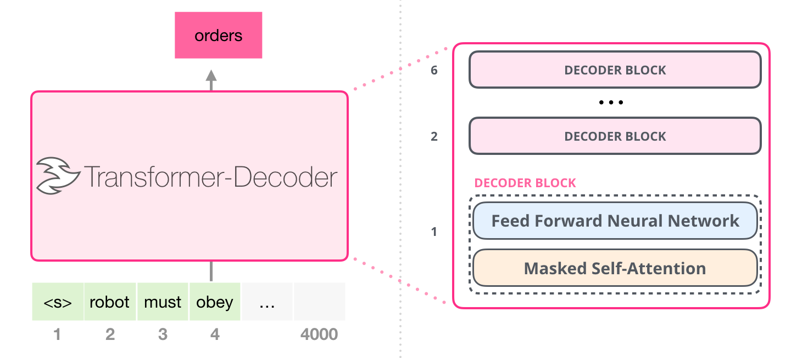
Zoom in the Decoder Layer
https://jalammar.github.io/illustrated-gpt2/

Slide 10
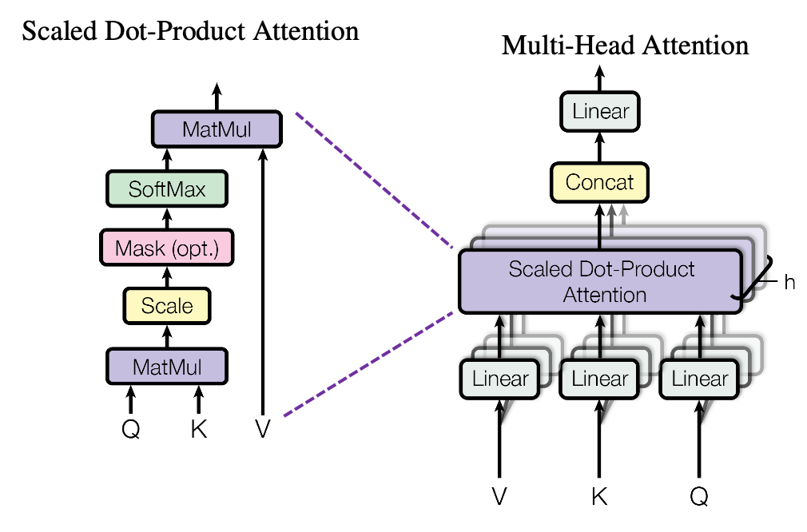
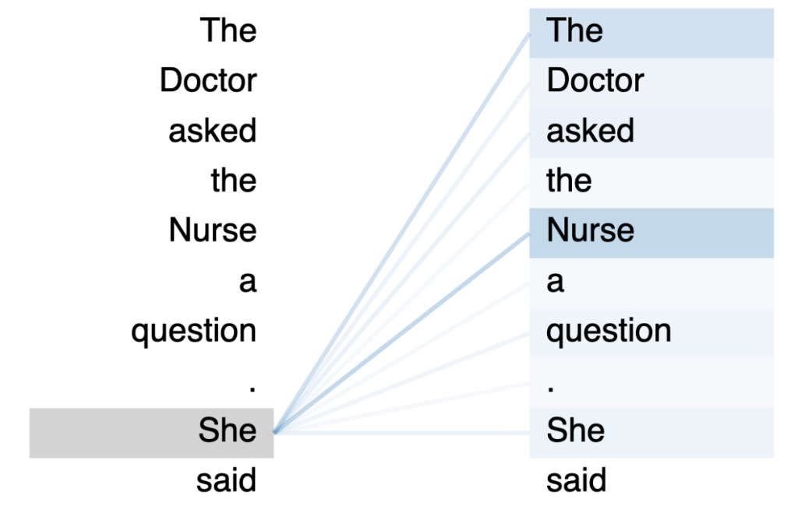
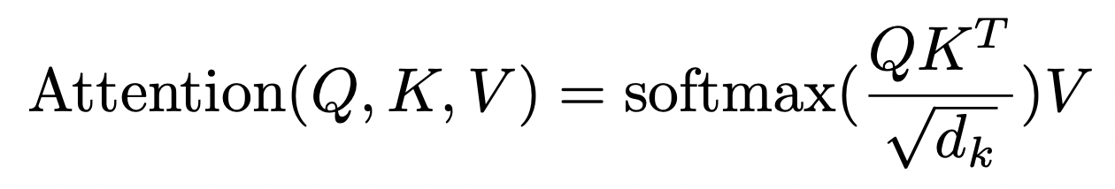
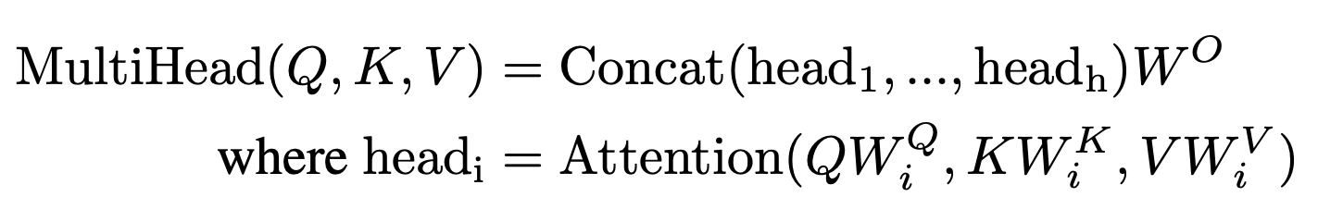
Zoom in the Masked Self-Attention
Attention is all you need
Notes:
Multiple heads with same architecture but different model weights
Each head can be computed in parallel
First Project Input embedding for each head, and input to different
The results of each head would be concat together and feed into a linear layer
To generate the input embedding for FFN
Zoom in the scaled dot product attention
The formula is quite straightforward
The softmax function will generate the attention 梅matrix we commonly talk about (dimension: seq len * seq len)
Each row of probability (denoted by the color here) means how much a word should attend to the other words in the sequence.

Slide 11
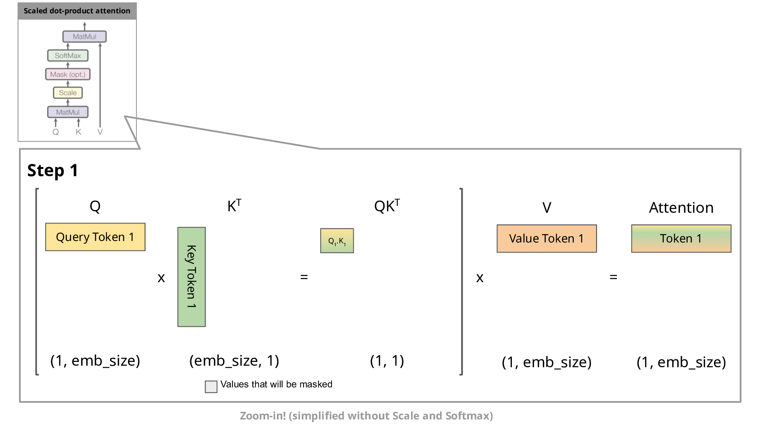
Zoom in Scaled Dot Product Attention
KV Cache to reduce recomputation in inference
https://medium.com/@joaolages/kv-caching-explained-276520203249
Notes:
There is an important optimization that is made in computation of attention during inference
Remember decoder-only model generate one token at a time
To generate a sequence of text, it needs to repeatedly inference the model
so it leads to some rooms for optimization
During the repeated model inference inside attention layer
As Shown in these examples in every step, we are generating one more tokens and put it into the context
so we have one more row of K or V matrix every time. and to calculate the updated attention matrix and attention output we are basically reusing the K and V from previous iterations,
while previous Q matrix can be dropped as it does not contribute to the results for the current iteration
So we will store these intermediate matrix to save computation for the future iteration, and we call it KV cache
If we inference the model from scratch every time, we found that the projection matrix of K and V from previous context are basically duplicated
Which means, we are computing the projection matrix of K and V again and again

Slide 12
Recap: Transformer Architecture
Attention is all you need
Notes:
Positional Encoding
Self-Attention

Slide 13
How did the Deep Learning community end up with Transformers?
Advantage
Highly Paralizable / Scalable
Long Term Memory
Disadvantage
Sensitive to Data Quality and Quantity
High Computational Demand
Notes:
Transformers can process input data in parallel, rather than sequentially (like RNNs). This parallelization significantly speeds up training and inference, making them highly efficient on modern hardware like GPUs and TPUs. Transformers can scale very well with the amount of training data and model size. Larger transformer models tend to achieve better performance, making them suitable for tasks where extensive data is available.
Thanks to the self-attention mechanism, transformers can effectively manage long-range dependencies within data. This allows them to remember and utilize context from earlier parts of the input, regardless of the length, which is a significant improvement over traditional models like RNNs and LSTMs.
Transformers require large amounts of high-quality training data to perform effectively. They are particularly sensitive to the quality of data,
The architecture of transformers, especially large models like GPT-3, demands substantial computational resources. They require powerful GPUs for training, which involves high energy consumption and considerable computational time.
Let us look at how much resources do we need to train and inference a LLM

Slide 14

Computation Resources Needed For LLMs
Training
Model: GPT-3 175 B.
350GB model weight for half-precision training
350GB activation, gradient, per optimizer state
Resources: V100 w/ 32GB GPU memory
Time: 355 GPU years over 300 Billion tokens
Cost: > $4.6M for V100
Inference
Model: GPT-3 175 B.
350GB model weight
~700 GB KV Cache for 100 concurrent sequences with context length 1000
Energy consumption
https://lambdalabs.com/blog/demystifying-gpt-3
Notes:
Scalability

Slide 15
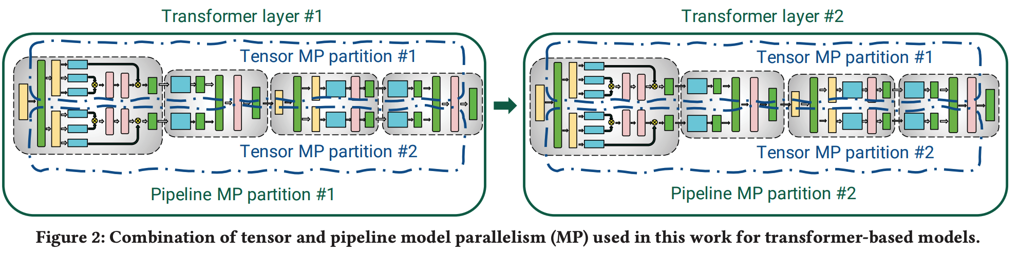
Characteristics of Transformers - Training
Huge Model Size
Need efficient parallelism for computation and communication
Long training time
Need efficient fault tolerance systems
Efficient Large-Scale Language Model Training on GPU Clusters Using Megatron-LM
Notes:
After talking about all these concept of transformer, let’s look at how they are different from previous DL model training or inference
And figure out why we need different system design for LLM training and inference
As i mentioned before, Transformers can scale very well with the amount of training data and model size. Larger transformer models tend to achieve better performance,
One GPU can no longer hold the model
Tensor: 𝑙 · 8𝑏𝑠ℎ, 2 all-reduce
Pipeline: bsh, p2p

Slide 16
Characteristics of Transformers - Inference
Auto-regressive decoding
The model generates one token at a time, taking into account previous token
Notes:
Compare to previous image model inference
Transformer model, especially decode-only model, inference is unique
first

Slide 17
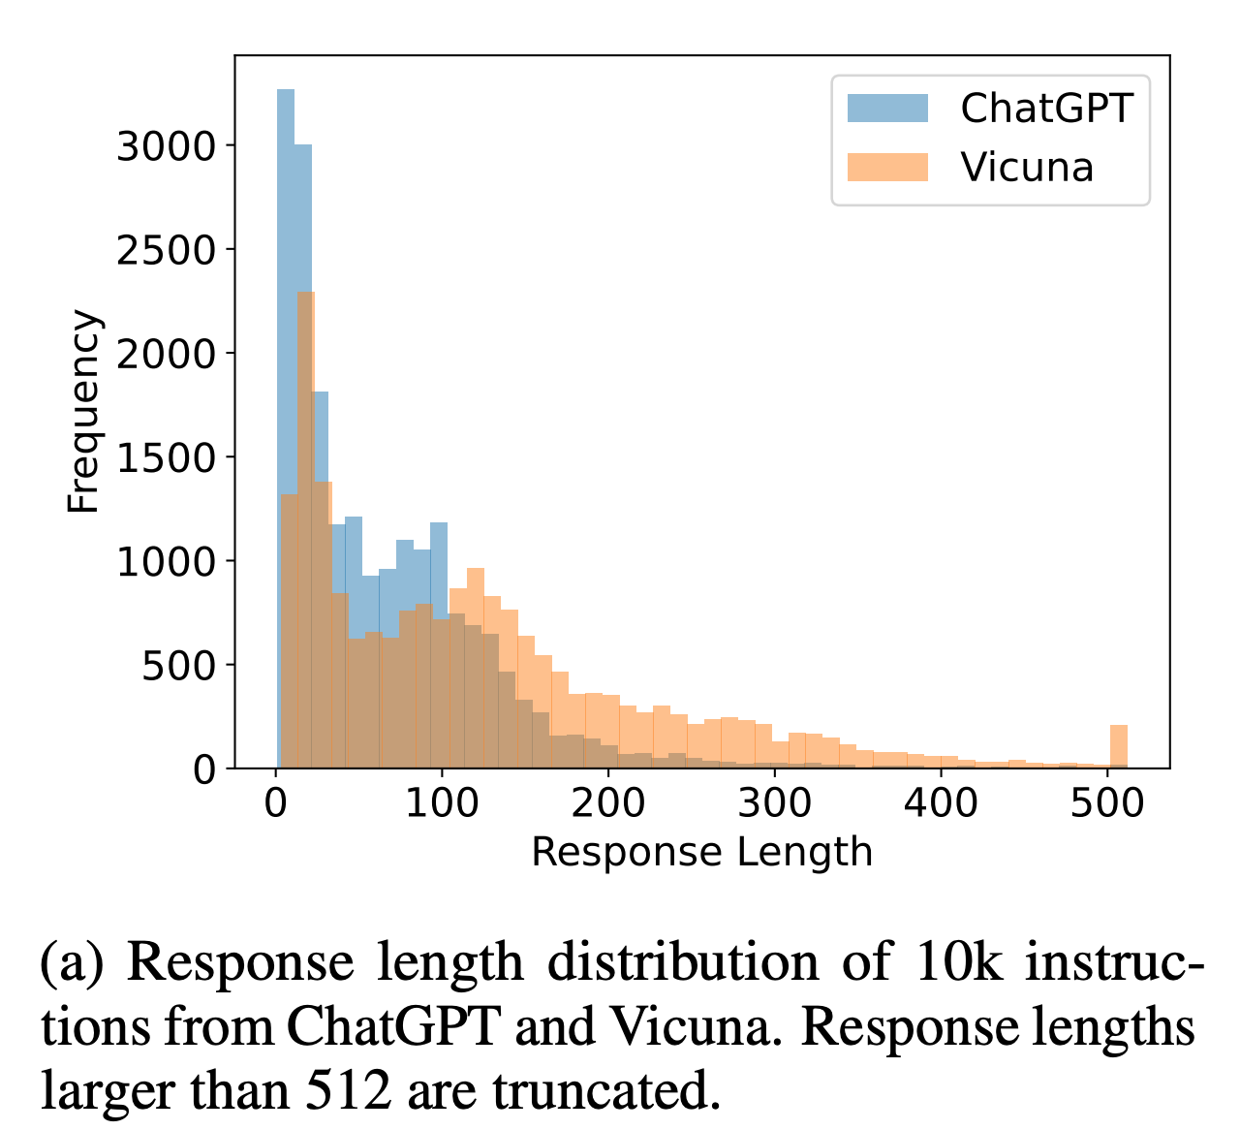
Characteristics of Transformers - Inference
2. Unknown response length → Unknown inference latency
Response Length Perception and Sequence Scheduling: An LLM-Empowered LLM Inference Pipeline
Notes:
Compare to previous image prediction, the prediction latency can be easily predicted, which help us schedule resources efficiently

Slide 18
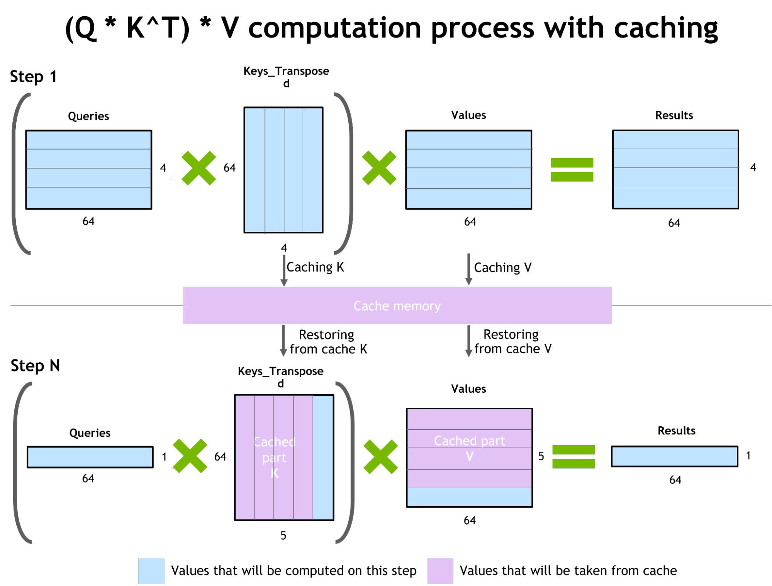
Characteristics of Transformers - Inference
3. Different computing phase
Prefill: digest prompt
Decode: predict next token
https://developer.nvidia.com/blog/accelerated-inference-for-large-transformer-models-using-nvidia-fastertransformer-and-nvidia-triton-inference-server/

Slide 19
Characteristics of Transformers - Inference
4. Memory capacity intensive due to KV Cache
Long context sequence
https://developer.nvidia.com/blog/accelerated-inference-for-large-transformer-models-using-nvidia-fastertransformer-and-nvidia-triton-inference-server/
Notes:
4260 gpu month

Slide 20
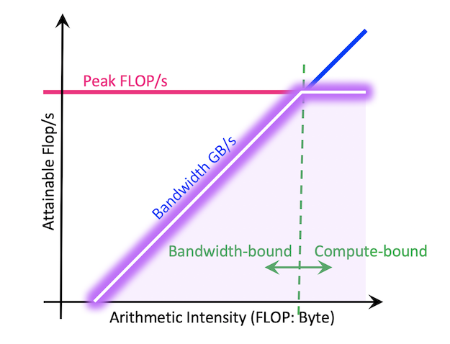
Characteristics of Transformers - Inference
5. Memory IO Bounded
GPU's performance is limited by the speed at which it can read from or write to its memory
GPU | Mem Bandwidth (GB/s) | FLOPs (Tensor) | Arithmetic Intensity
V100 | ~900 (HBM2) | 125 TFLOPS | ~140
A100 | ~1555 (HBM2) | 312 TFLOPS | ~200
Notes:
The intuition is that gpu is good at parallel computation, such as large-scale matmul
However, when handling not highly parallelizable computation, GPU's performance is limited by the speed at which it can read from or write to its memory
This is the intuition of this roofline model.
312 * 10^12 / (1555 * 10^9)

Slide 21
Characteristics of Transformers - Inference
5. Memory IO Bounded
GPU's performance is limited by the speed at which it can read from or write to its memory
Arithmetic intensity for
Vector - matrix multiplication in Attention layer ≈ 2
Matmul in FFN layer ≈ 2 * Batch Size
https://developer.nvidia.com/blog/accelerated-inference-for-large-transformer-models-using-nvidia-fastertransformer-and-nvidia-triton-inference-server/
Notes:
312 * 10^12 / (1555 * 10^9)

Slide 22
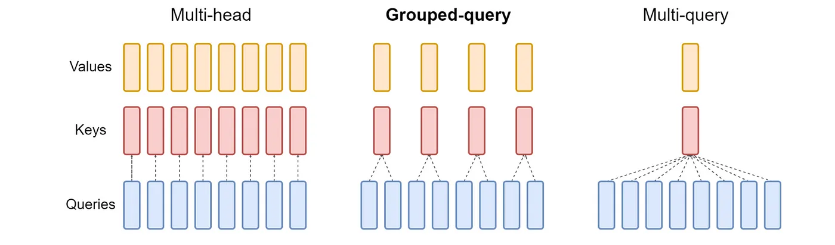
Characteristics of Transformers - Inference
5. Memory IO Bounded
GPU's performance is limited by the speed at which it can read from or write to its memory
Arithmetic intensity for
Vector - matrix multiplication in Attention layer ≈ 2
Matmul in FFN layer ≈ 2 * Batch Size
Other attention structure with higher arithmetic intensity
https://developer.nvidia.com/blog/accelerated-inference-for-large-transformer-models-using-nvidia-fastertransformer-and-nvidia-triton-inference-server/
Notes:
312 * 10^12 / (1555 * 10^9)

Slide 23
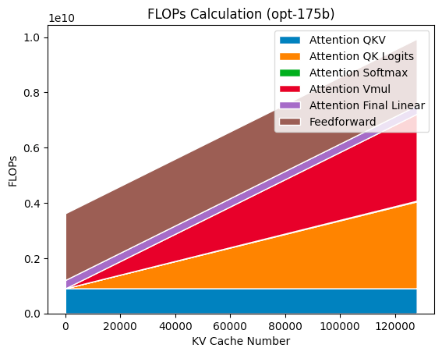
Observation of Transformers - Inference
6. Inference FLOPs breakdown – Batch size = 1
Insu Jang

Slide 24

Efficient LLM Inference System Solutions
Compression, Quantization, Pruning
Parallel computation
Memory management
Request scheduling
Kernel optimization
Reference:
Efficient Large Language Models: A Survey
https://github.com/AmberLJC/LLMSys-PaperList/
Notes:
After talking so many unique characteristics of large language model serving
it is now time to transition to a high-level overview of the existing strategies that enable efficient inference for large language models and
in the remaining of this semester we are going to explore more solutions designed to improve the speed and efficiency of inference
and I have categorized the primary solutions into 5 key approaches and you'll notice that the research papers list on our course page align with one or more of these categories eventually
because they’re all inspired by the characteristics that I mentioned earlier

Slide 25
LLM Challenges & Future Direction
Hallucinations
Limited Context Length
Misaligned Behavior
Develop GPU alternatives
Notes:
Mitigating hallucination and developing metrics to measure hallucination is a blossoming research topic. There are also ad-hoc tips to reduce hallucination, such as adding more context to the prompt, chain-of-thought, self-consistency, or asking your model to be concise in its response.
Retrieval Augmentation. One way to mitigate hallucinations is to ground the model’s input on external knowledge, which is often referred to as retrieval augmentation
Limited Context Length are a barrier for handling long inputs well to facilitate applications like novel or textbook writing or summarizing.
ensuring that the LLM’s behavior aligns with human values, objectives, and expectations and that it does not cause unintended or undesirable harms or consequences
Instruction Fine-Tuning
Pre-Training With Human Feedback
Reinforcement Learning From Human Feedback (RLHF)

Slide 26
Q & A
Notes:
The amount of energy in joule used by a 10-watt LED light bulb in one hour

